Slide 1

TESLA Stock Price Prediction using Machine Learning

Slide 2
Objective
The goal of this project is to predict the future stock prices of Tesla (TSLA) using machine learning algorithms. The project employs three different regression models: Linear Regression, Support Vector Regression (SVR), and Random Forest Regression. These models are trained on historical stock price data and can predict future stock prices based on various input features. The project also includes a front-end interface where users can input features to receive real-time stock price predictions.

Slide 3
Team Members and their Contribution
Member Name | Contribution
1. Souritra Nandy | Dataset Collection, Data Pre-processing, ML model development, Integrating the Front-end with the model
2.Shyamal Ghosh | ML Model Development
3.Shrutakirti Chakroborty | Front-end and ML model Development
4.Indrajit Dey | Front-end Development

Slide 4
Technologies Used
1.Machine Learning Model Development | Python(Libraries like numpy, pandas, seaborn, matplotlib etc and Algorithms like LinearRegression, SVR, RandomForestRegression)
2.Front-End | HTML5 ,CSS3, JavaScript
3.Back-end | Flask

Slide 5
Dataset Description
The dataset contains historical stock data for Tesla, with 1,692 entries and 7 columns. Below is a description of the dataset: Columns: Date: The trading date (in MM/DD/YYYY format). Open: The stock price at the opening of the trading session (in USD). High: The highest stock price during the trading session (in USD). Low: The lowest stock price during the trading session (in USD). Close: The stock price at the close of the trading session (in USD). Volume: The total number of shares traded during the session. Adj Close: The adjusted closing price, accounting for corporate actions such as stock splits or dividends (in USD). Dataset Characteristics: Date Range: From June 29, 2010, to the most recent date in the dataset. Data Types: Numeric: Open, High, Low, Close, Volume, Adj Close. String: Date.

Slide 6
Data Pre-Processing
Operation | Result
Checking for null Values | Dataset does not contain any null values
Checking if all the features’ data are in suitable format or not | One Column(Date) is not in processable format. So, we converted into a suitable format(datetime)
Checking for duplicate column | Two columns contain same data(Close and Adj Close), so we have discarded one of them(Adj Close)
Checking for outliers | After plotting certain graph we have seen that one column contains outliers( Volume column contains outliers)
Dataset Splitting for training and testing | Dividing the dataset for Model development(80% training and 20% testing)

Slide 7
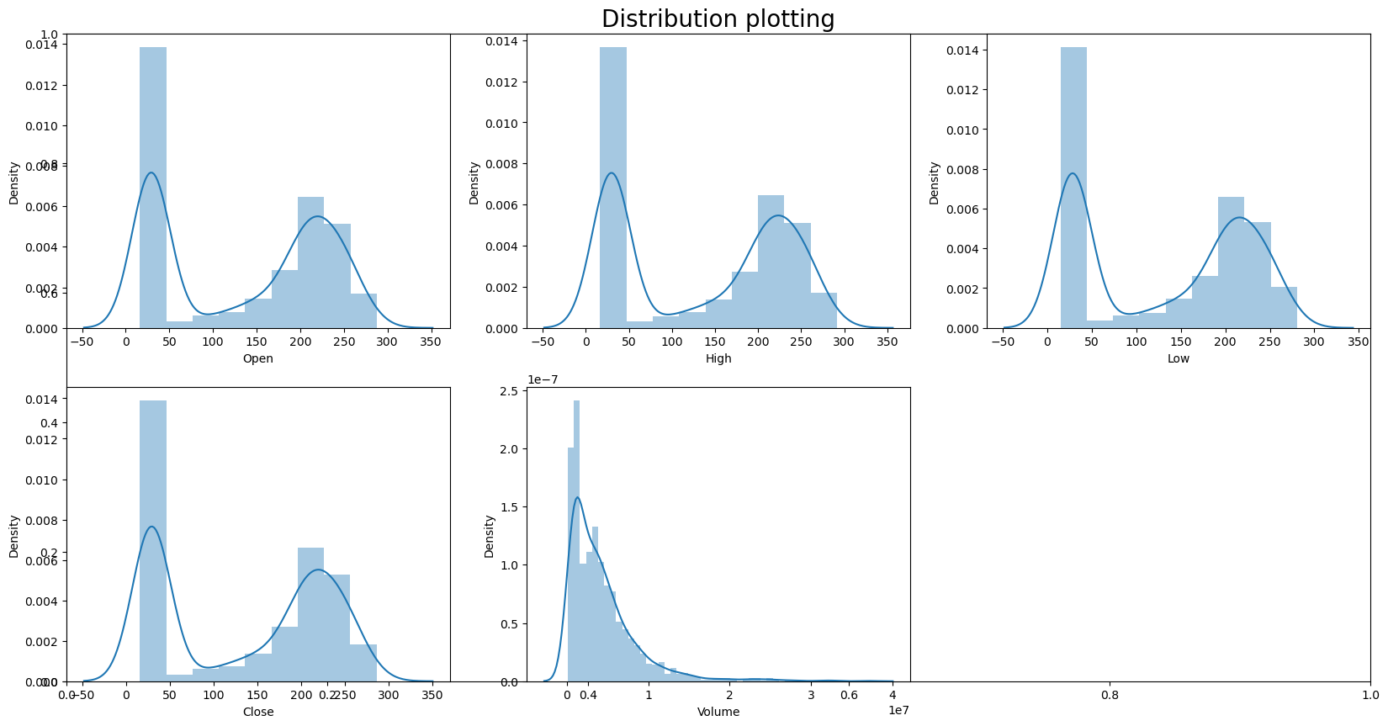
In the distribution plot of Open, High, Low, Close data, we can see two peaks which means the data has varied significantly in two regions. And the Volume data is left-skewed.

Slide 8
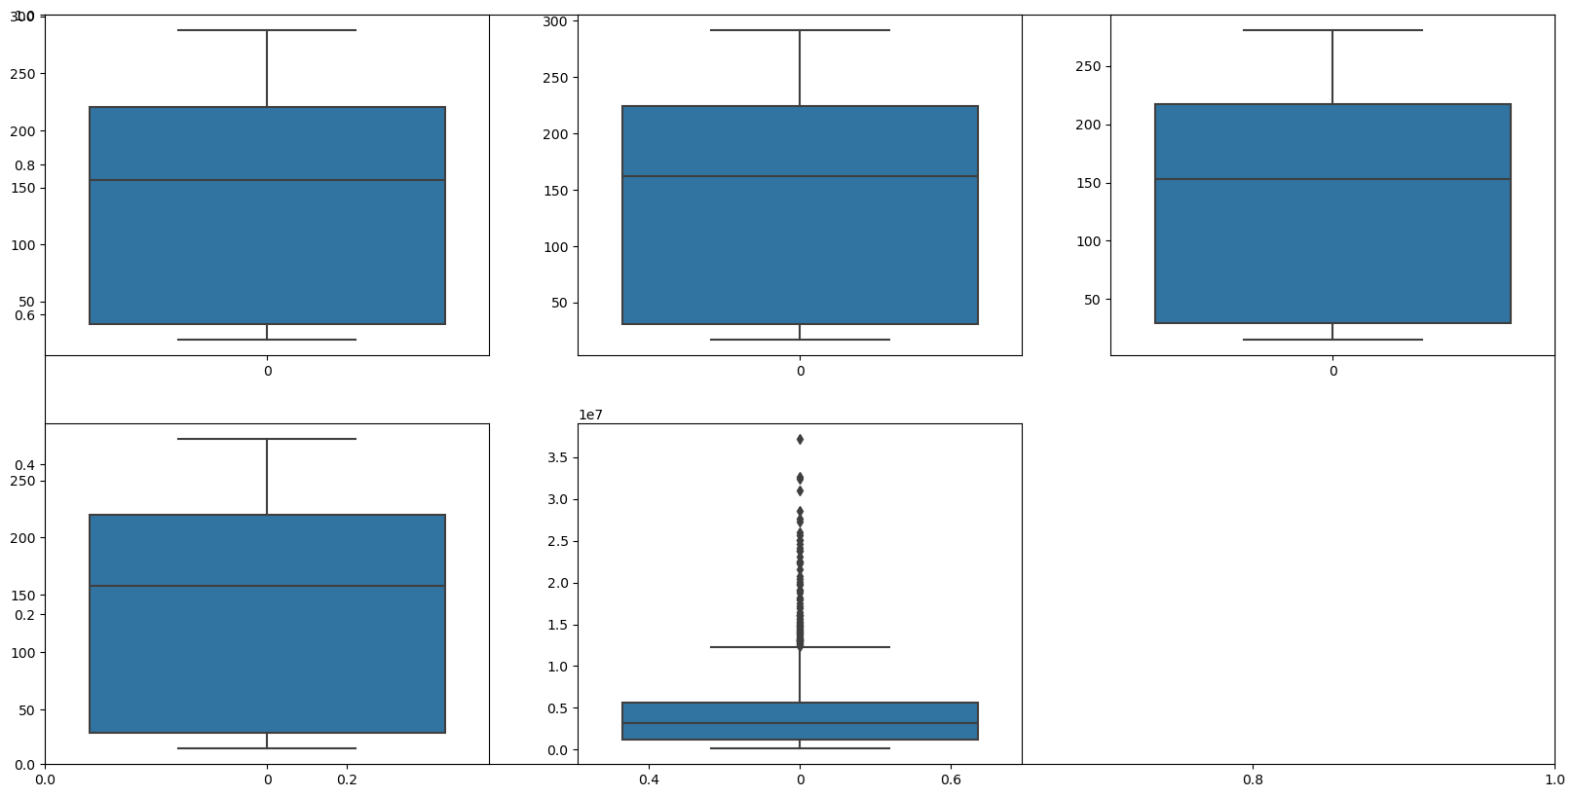
From the above boxplots, we can conclude that only volume data contains outliers in it but the data in the rest of the columns are free from any outlier.

Slide 9
Feature Selection
Among the five features(as ‘Adj Close’ has been removed due to its duplicity with ‘close’), we have chosen four features for training that is [Open, High, Low and Volume] for training the model.
These features are stored in a variable named ‘x’ which represents independent variables(input features)
The ‘close’ feature is stored in variable named ‘y’ which represents the dependent variable(target feature)

Slide 10
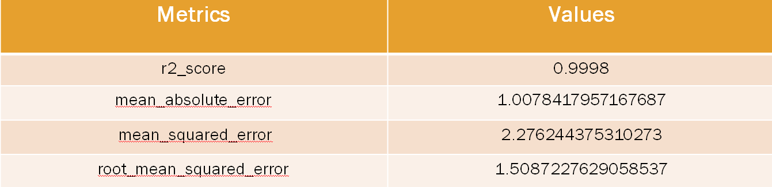
Applying Linear Regression Model
After fitting the training data in the linear_regression model which is available in sklearn.linear_model library in python, we get the results as follows:
The r2_score of this model is quite close to 1 which defines that the model has a high prediction accuracy in this dataset

Slide 11
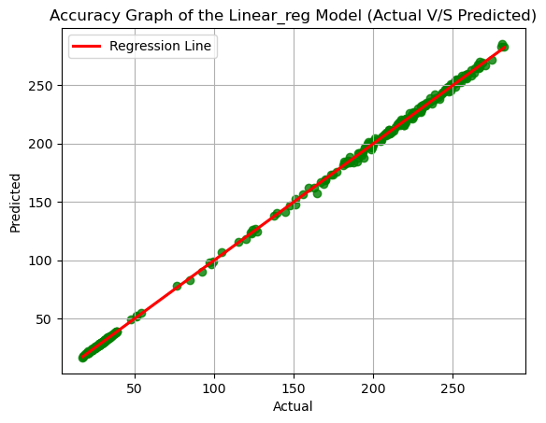
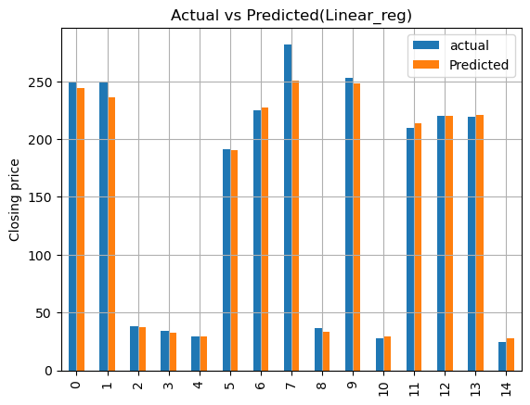
Accuracy graphs

Slide 12
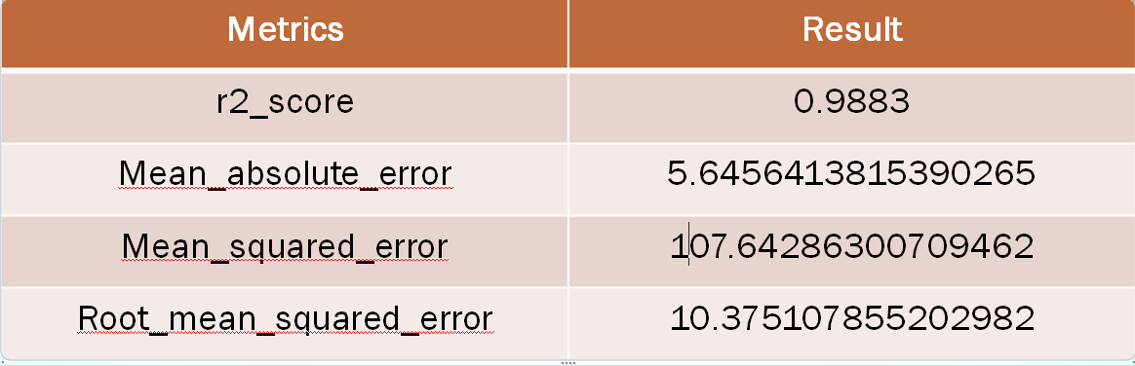
Applying SVR
Before fitting the data into SVR, we performed feature scaling by ‘StandardScaler’(as SVR is highly sensitive to feature scales)which is available in the ‘sklearn.preprocessing’ module. After that, we split the normalized dataset and again into training(80%) and testing data(20%) and fitted it into the SVR model. After fitting the training data, we get the result as follows:
The r2_score is quite good of this model but is lesser than the Linear_Regression model.

Slide 13
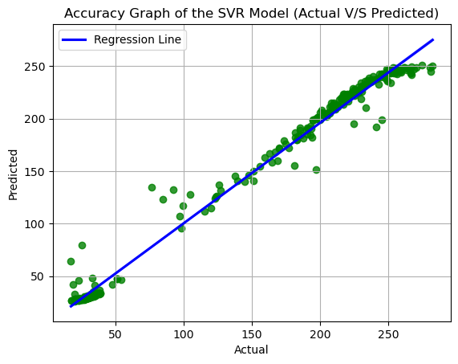
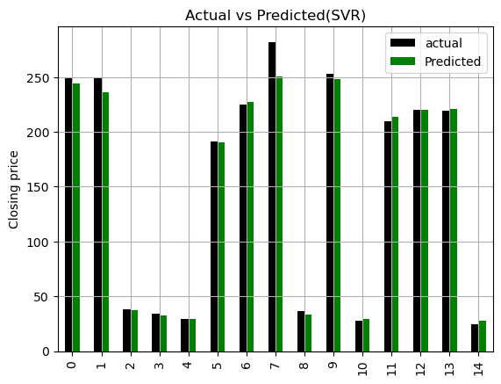
Accuracy Graphs

Slide 14
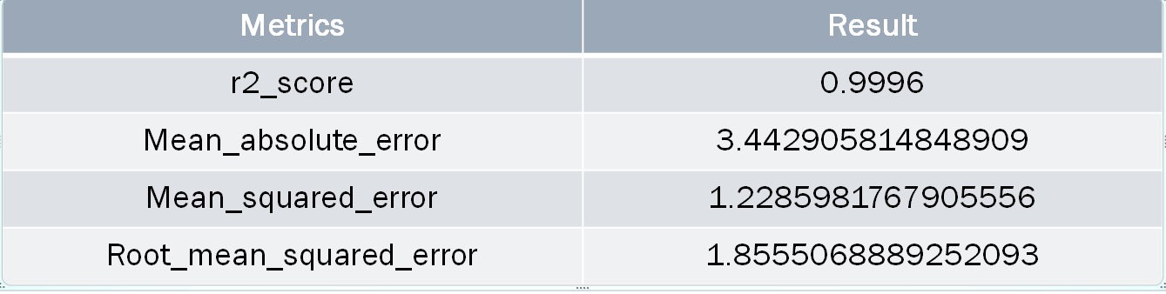
Applying RandomForest Regression
We fit the training data into the RandomForestRegression model with ‘n_estimators’ value of 500 and we get the following results.
The r2_score of the RandomForestRegression is quite high and is better than the SVR but is little bit lesser than Linear_Regression

Slide 15
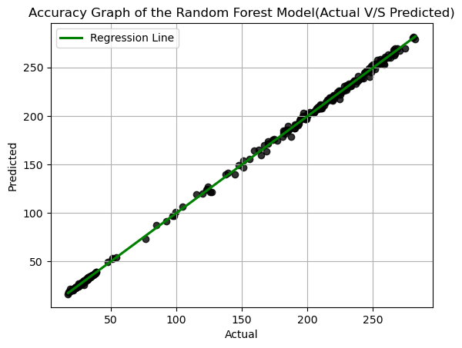
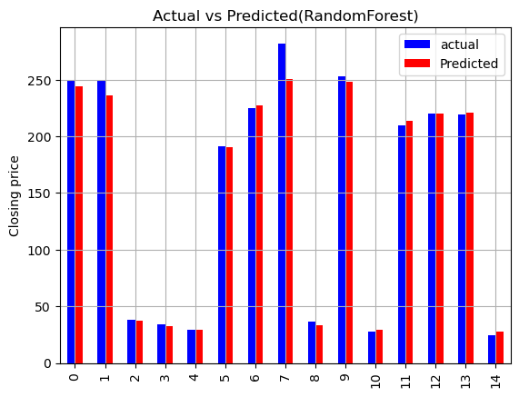
Accuracy Graphs

Slide 16
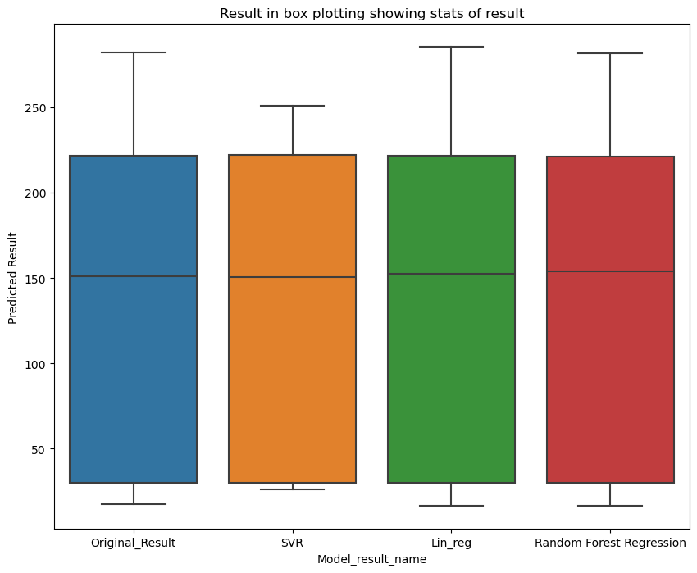
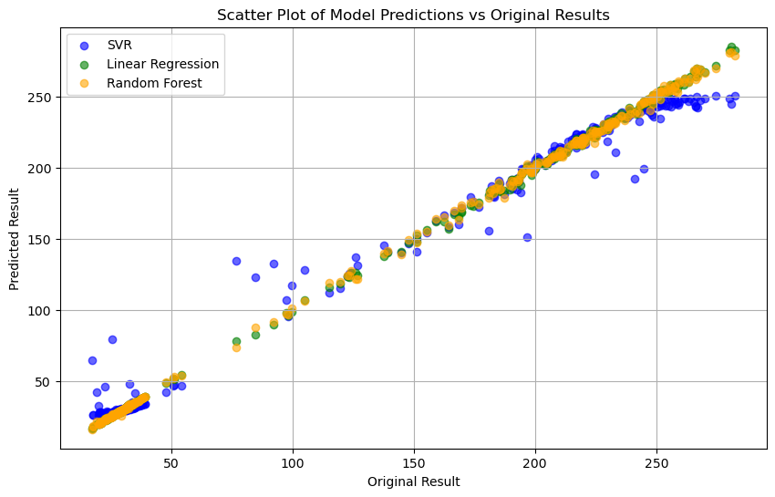
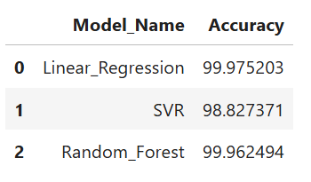
Comparison of Results

Slide 17
Conclusion
🌟 Model Performance Analysis 🌟
After evaluating multiple models for stock price prediction, we observed a remarkable level of prediction accuracy across all the models. However, Linear Regression emerged as the top performer with an outstanding accuracy of 99.98%.
📈 Why Linear Regression? With its exceptional performance and near-perfect accuracy, the Linear Regression model has been selected as the best model for predicting stock prices. It strikes the perfect balance between simplicity and effectiveness, making it the ideal choice for reliable predictions.
✨ Final Decision: The Linear Regression model will power our stock price prediction tool, ensuring precise and trustworthy forecasts for users.

Slide 18
THANK YOU!

